Slide 1
Laser Harp
Team Light Music
Notes:
Garek Introduces the Group in MSEE 180 Tuesday 2:30

Slide 2
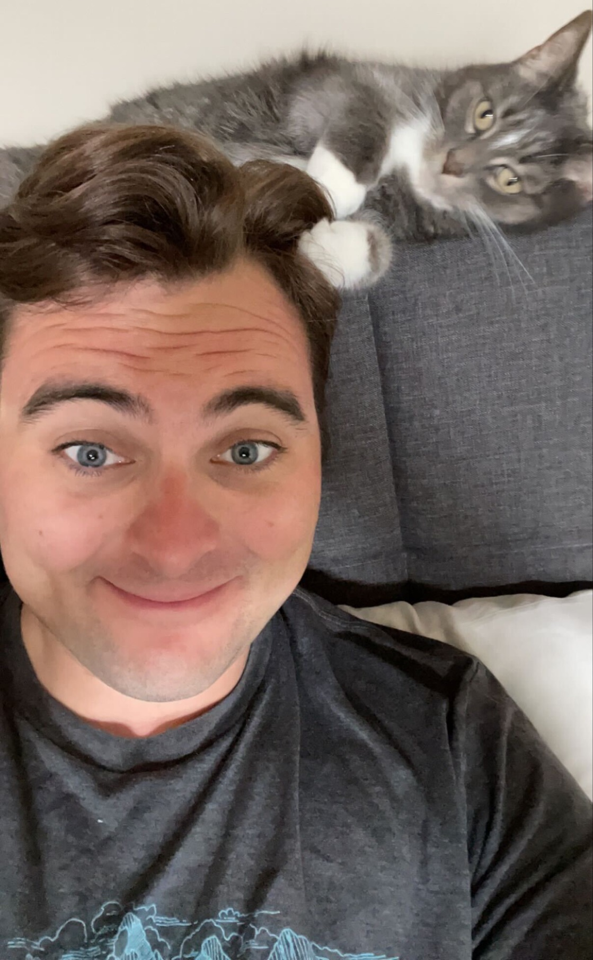
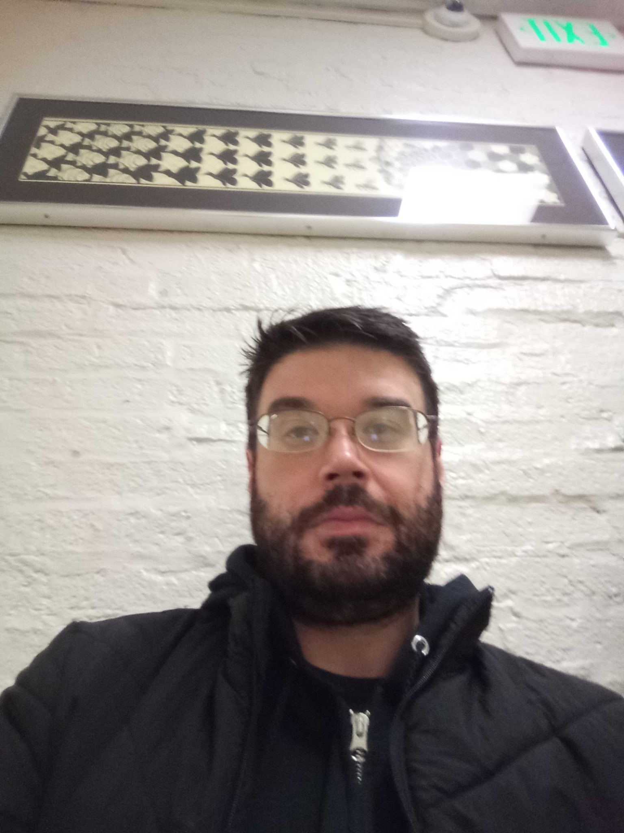
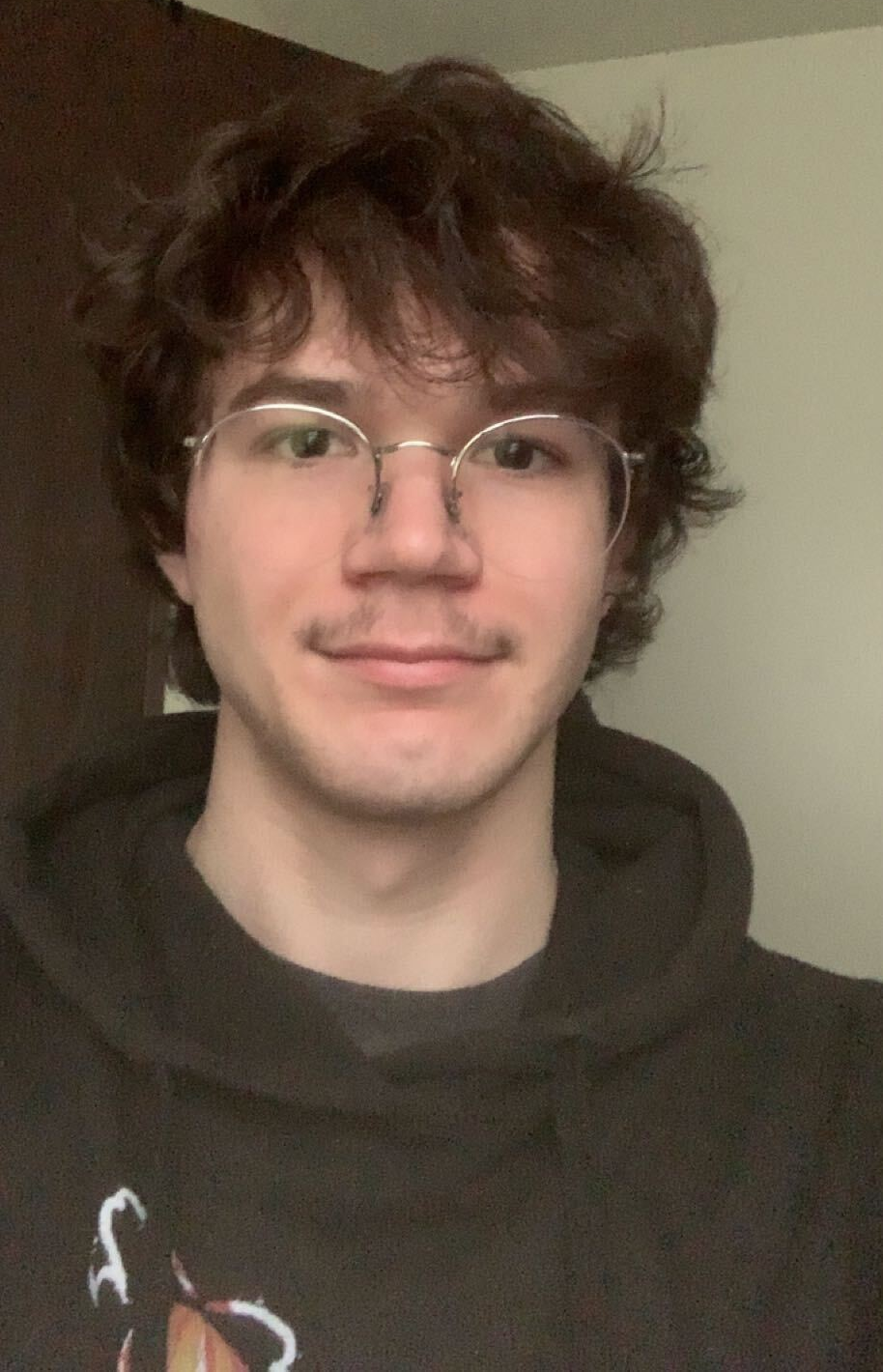
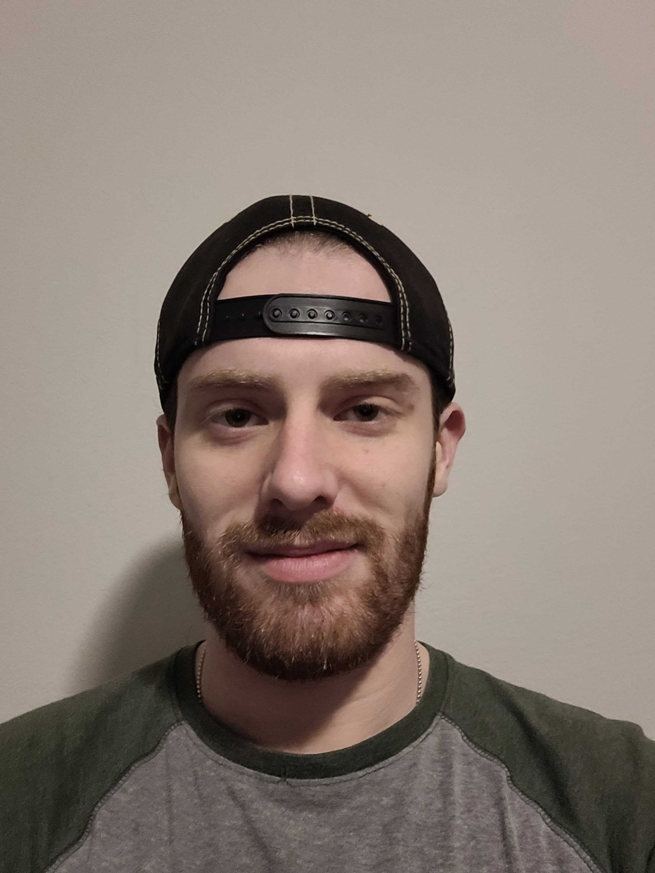
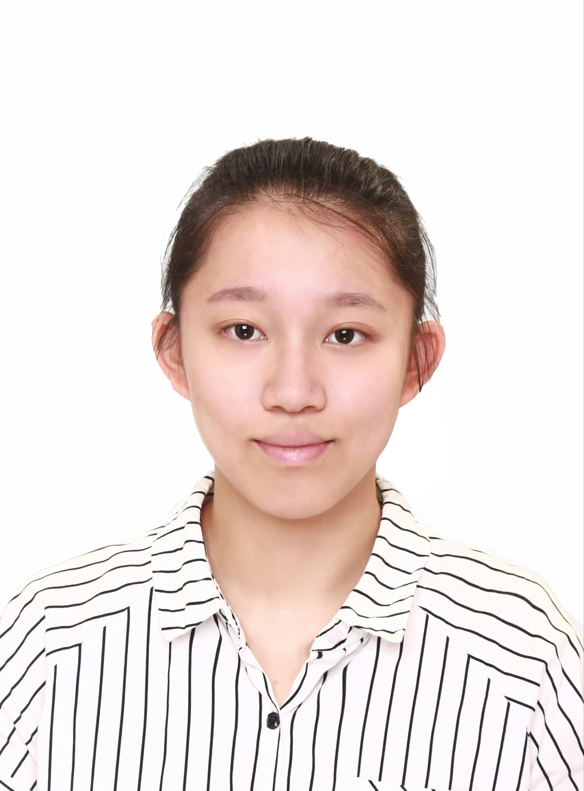
Introduction
Nick Damato
Purchasing
Electrical Engineering ‘23
ndamato@purdue.edu
Steven Jurcin
Facilitator
Electrical Engineering ‘23
sjurcin@purdue.edu
Ben Hodonicky
Team Lead
Electrical Engineering ‘23
bhodonic@purdue.edu
Garek Huntzinger
Communications
Electrical Engineering ‘23
ghuntzin@purdue.edu
Jingyi Zhang
Facilitator
Electrical Engineering ‘23
zhan4129@purdue.edu
Notes:
Everyone Introduces themselves

Slide 3
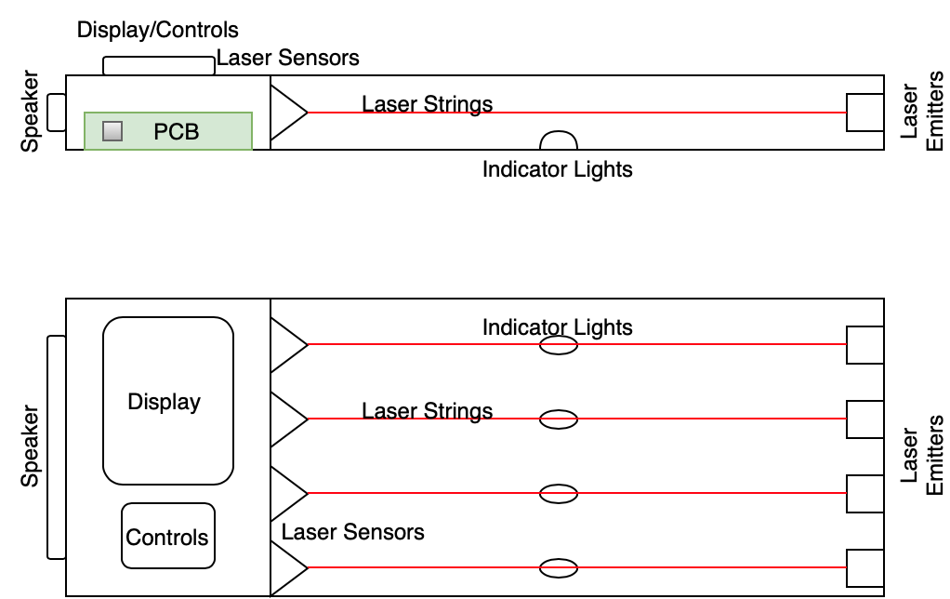
The Pitch
Notes:
Ben Speaks here

Slide 4
The Users
Core User: Norbert the Novice
Looking for beginner instrument
Would like to learn basic songs and melodies
Needs a simple interface to convey these basic melodies/riffs
Other Potential User: Harriet the Harpist
Advanced Musician
Wants to utilize skills in a new way
Notes:
Matt the Musician is interested in a beginner instrument that teaches him some basic musical concepts such as pitch and melody. He needs a simple, intuitive interface that can convey to him basic riffs or songs without prior knowledge of music theory. Matt would like to create his own melodies or songs when inspiration strikes his mind. He also thinks lasers are cool, and would like to show off his instrument and songs to his friends.
Harriet the Harpist is looking for a new way to express herself musically. She already has experience as a harpist, and would like to transfer her skills to an electronic instrument. She wants this device to look awesome while performing and incorporate lasers as well.
Based on these user stories, the high-level design requirements for the laser harp are described below.

Slide 5
Requirements Overview
The device must be able to emit beams (strings) of light.
The device will detect if a string has been broken.
The device must have the ability to output audio/sound.
The output tone will correspond to a given string.
The device will store sequences of tones.
The device must be able to playback stored sequences of tones.
The device will indicate which string to pluck when teaching a sequence of tones.
The device must be able to switch between different octaves/voices.
The device will indicate to the user the current octave/voice range.
The triggered note/pitch will be visually displayed.
The selected key/scale will be visually displayed.
The strings will have the Western scale sequence of “Do Re Mi Fa So La Ti Do”
The strings have the ability to be changed to different scales/keys.
Notes:
JINGYI ZHANG only need to describe highlight ones and may explain why we need this requirement( functional or for social rule).2 to ensure device work well. 4 and 7 to make sure which output we are making. 12 to make sure music rule of instrument. 6 we will set a song selection and generation tone button.

Slide 6
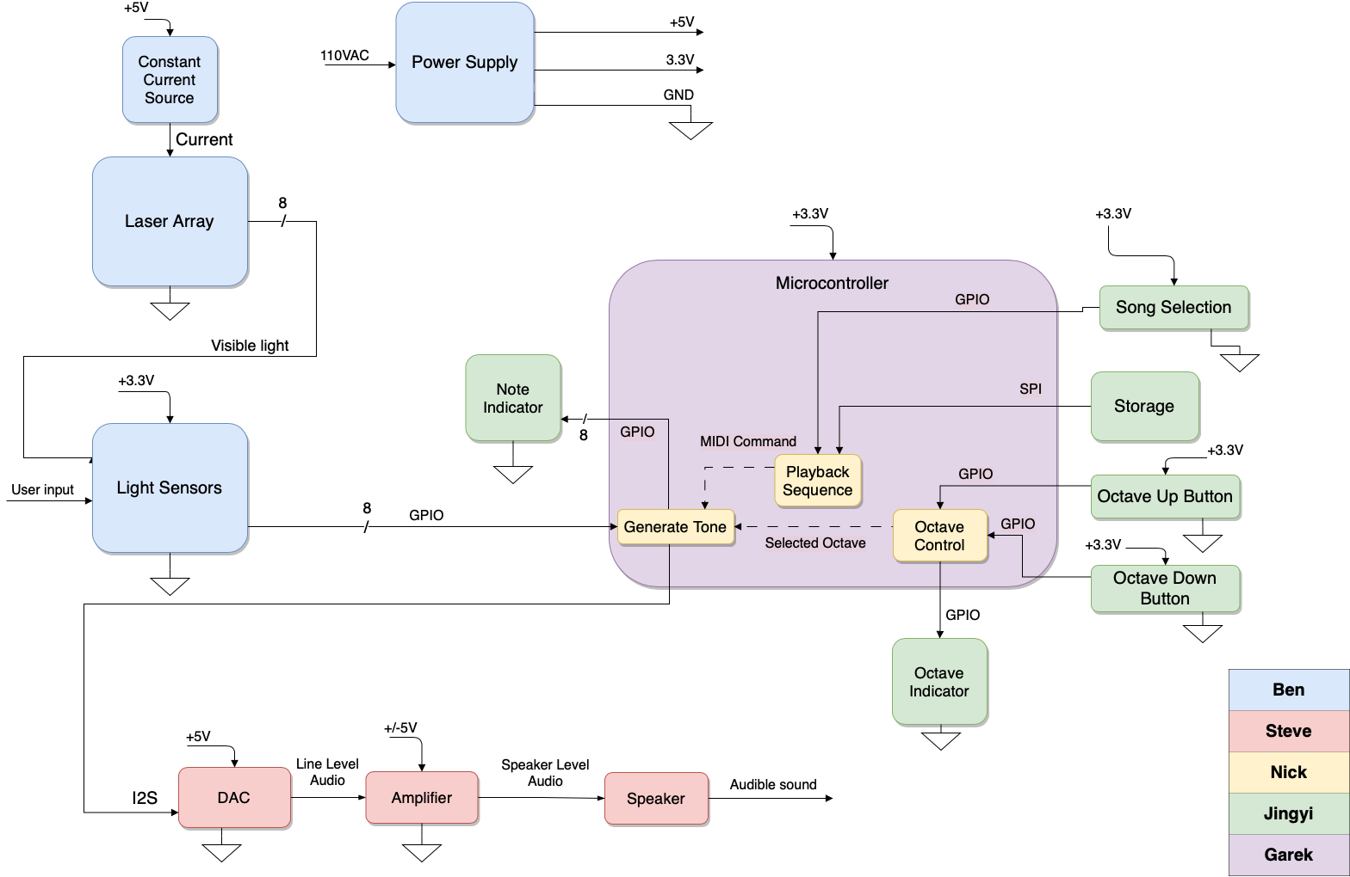
Block Diagram
+
Notes:
Nick goes over Block Diagram

Slide 7
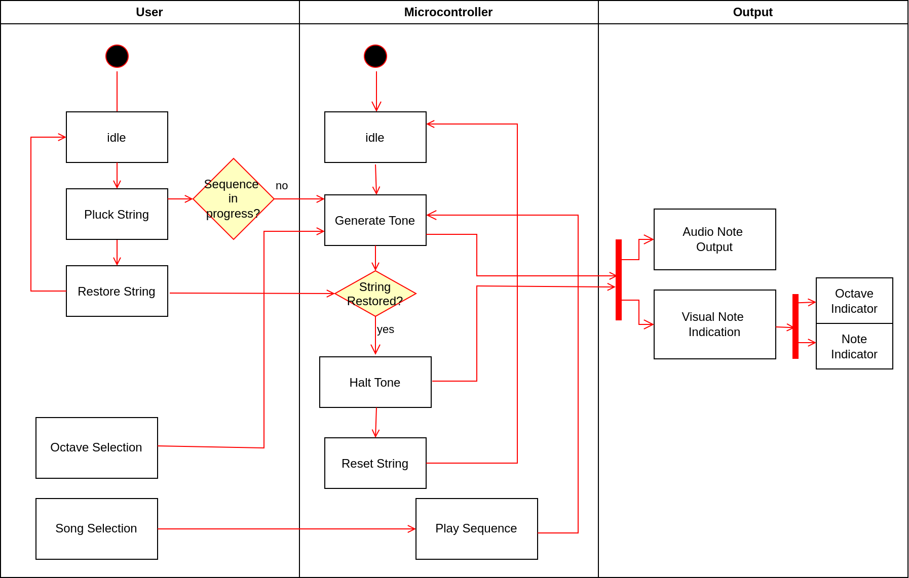
User Activity Diagram
Notes:
Steve goes over Activity Diagram

Slide 8
The Plan
Week 3: Get Approved & Final Design Specifics
Week 6: Finalize Subsystem Prototypes
Week 7: Demo Subsystems
Week 8: Finalize PCB Design
Week 10: PCB order complete
Week 12-13: Test Final Prototype
Week 15: Final Demo & Finalize Documentation
Week 16: Relax
Notes:
Garek goes over plan

Slide 9
Challenges/Concerns
Realizing a complex design that utilizes a microcontroller
Determining what peripherals to use for note/octave/song indication and song selection
Notes:
Garek goes over concerns

Slide 10
Questions?

